Slide 1
Search Engine Marketing
Major Project

Slide 2
Q1) Carefully examine the image attached below and answer the following questions
a) What kind of video ad is this?
The video ad in the image appears to be a YouTube video ad, likely a discovery ad that shows up in search results or on the homepage, prompting users to click and watch the video.
b) List out any 3 features of such ads.
Three features of YouTube video ads like this are:
1. Targeted Reach : They can be targeted to specific audiences based on demographics, interests, or search behavior.
2. Variety of Formats : There are several formats including skippable, non-skippable, bumper, and discovery ads.
3. Interactive Elements : Ads can include call-to-action buttons, end screens, and other interactive features to engage viewers.

Slide 3
c) Create a similar Ad for “Samsung Galaxy Fold”
Samsung Galaxy Fold: Unfold the Future
Discover the phone that's changing the shape of the future. The Samsung Galaxy Fold features a revolutionary flexible display that unfolds to deliver a full tablet experience. Dive into a larger, immersive display for multitasking, watch high-definition videos on a stunning screen, and capture life's moments with a versatile camera system.
Features:
Innovative Design : A seamless fold that fits comfortably in your pocket.
Versatile Camera : Six lenses for every angle, whether folded or unfolded.
Multitasking Mastery : Run three apps simultaneously and switch seamlessly.
Special Offer : Click now to unfold exclusive deals and experience the future today with Samsung Galaxy Fold.

Slide 4
Q2) Run a Google Search Ad campaign for a blog post on a website. (It’s not compulsory to spend money, creating a campaign is important)
Creating a Google Search Ad campaign for a blog post involves several steps. Here's a simplified guide to help you get started:
1. Create a Google Ads Account : If you don't already have one, sign up for a Google Ads account.
2. Select Your Campaign Goals : Decide what you want to achieve with your campaign, such as driving traffic to your blog post.
3. Describe Your Business : Provide details about your business or the subject of your blog.
4. Set Your Geographic Area : Choose the locations where you want your ad to appear.
5. Choose Keywords : Select relevant keywords that potential readers might use to find content like yours.
6. Write Your Ad : Craft compelling ad copy that highlights the key points of your blog post.
7. Set Your Budget : Decide how much you want to spend on your campaign.
8. Review and Launch : Check all the details of your campaign and then launch it.

Slide 5
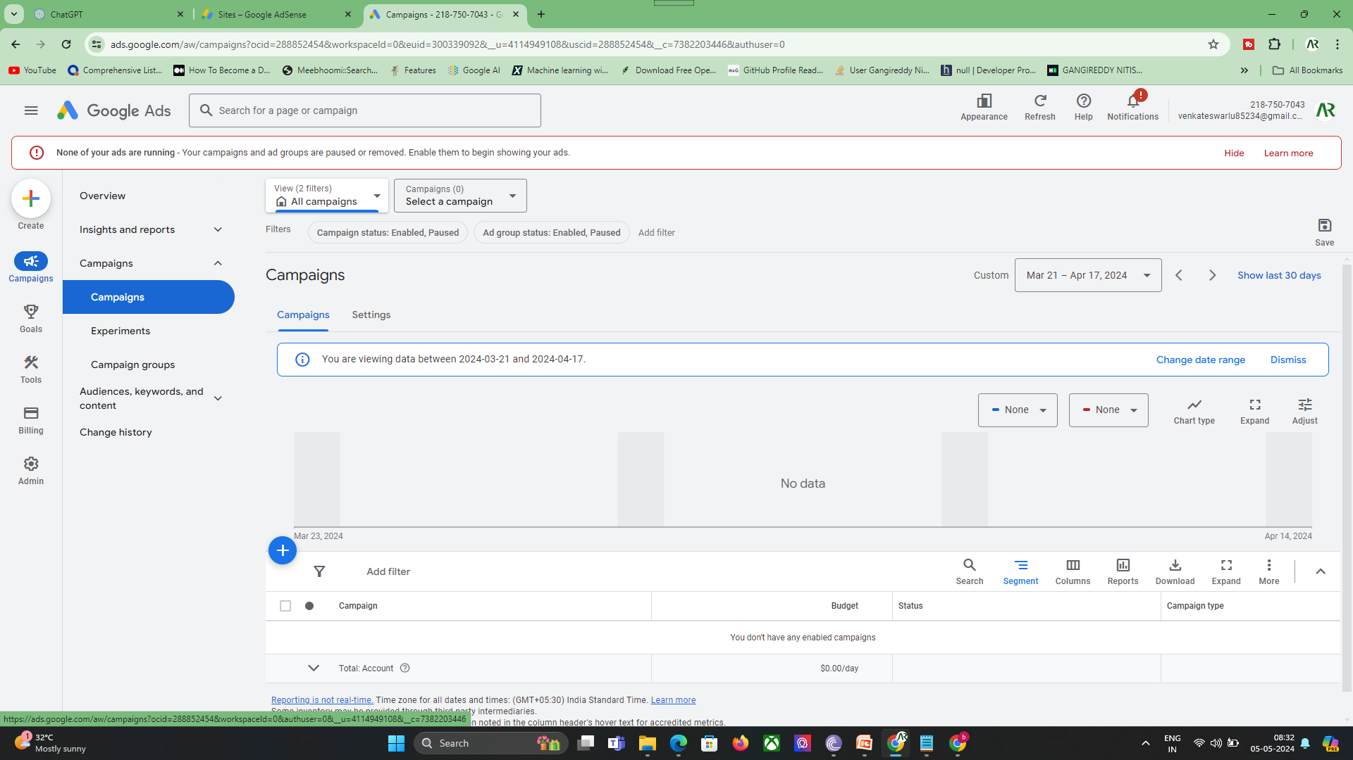

Slide 6
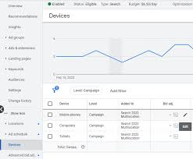
Q3) Run any type of google video ad campaign (It’s not compulsory to spend money, creating a campaign is important)

